Slide 1

Introduction
IGCSE Economics

Slide 2
Why did you choose Economics?
On tables, discuss why you chose Economics.
Be honest!
What do you know about the subject? (mindmap)

Slide 3
What will you learn?
In Year 10 - MICRO economics:
1.1 - Section A – The Market System
1.2 - Section B – Business Economics
Download the specification
In Year 11 - MACRO economics:
2.1 - Section C – Government and the Economy
2.2 - Section D – The Global Economy

Slide 4
The Exam
Paper 1 (50%) on Microeconomics 1.5 hours
Paper 2 (50%) on Macroeconomics 1.5 hours

Slide 5
Other assessment
ARR tasks
Presentations
Tests
Mock exams

Slide 6
Note taking
Slides will be available for you on Google classroom
Be organised! Create folders for Economics; create a new document every lesson
Use a notebook as you will need to write your exams and draw diagrams later in the year

Slide 7
Expectations
Note taking
Collaboration
Home learning (meet deadlines).
If you are unsure - read through it at home and/or come and see me.
Bookmark my Google Site

Slide 8
Genovia

Slide 9
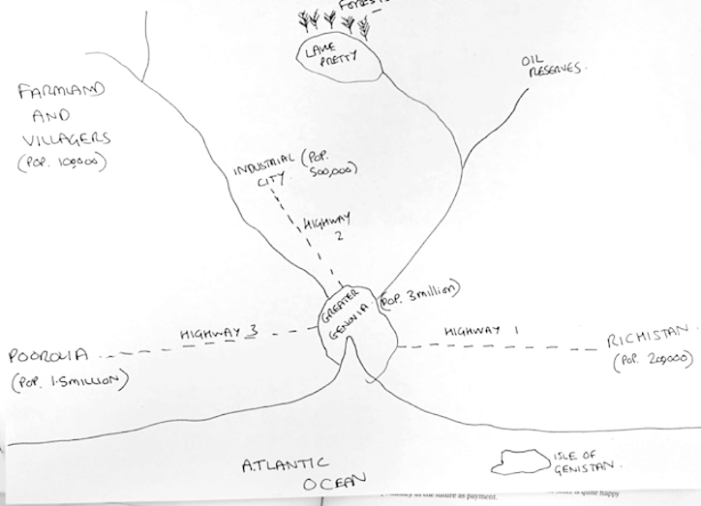

Slide 10
The Genovia Economy
How do we measure the economy of Genovia?
What position do you think it is in based on the map?
What products would the economy make?
You have been elected government - what policies and actions would you take?

